Slide 1
Data Visualization in Python
MTH1203 – Probability and Statistics
BSIT, Year 1, Semester 2
Group Research Work
Uganda Christian University
Group Members: Nabukenya Sarah, Amanya Aaron, Chelangat Ruth Hope, Mirembe Norah, Nakafeero Hadijah Karamagi, Simbilyabo David, Chelimo Hussein, Ampumuza Esther
Notes:
Good morning/afternoon. Our topic is Data Visualization in Python, for the Probability and Statistics course, MTH1203. We are a BSIT Year 1 group, and this project used Python to explore the Tips dataset with charts. I will hand over to my group members as we go through the slides.

Slide 2
Introduction
Data visualization means showing data using charts and graphs instead of plain numbers.
It helps us see patterns, trends, and relationships in data quickly.
Good charts make statistics easier to understand for any audience.
In this project, we used Python to create different charts from the Tips dataset.
Notes:
This slide explains what data visualization is. Data visualization means showing data using charts and graphs instead of plain numbers. It helps us see patterns, trends, and relationships quickly, and makes statistics easier to understand for anyone, even without a strong math background. In this project we used Python to build different charts from the Tips dataset.

Slide 3
Python Libraries Used
Matplotlib – the basic library for charts like bar, line, histogram, and scatter plots.
Seaborn – built on Matplotlib; makes charts like the heatmap and box plot easier.
Plotly – used to make an interactive chart that you can hover and zoom on.
Pandas – used to load and organize the data table.
Notes:
Here we introduce the four Python libraries we used. Matplotlib is the basic library for charts like bar, line, histogram, and scatter plots. Seaborn is built on top of Matplotlib and makes some charts, like the heatmap and box plot, easier to create. Plotly is used to make an interactive chart that you can hover over and zoom into. Pandas is used to load and organize the data table we worked with.

Slide 4
The Dataset
We used the Tips dataset, which comes built into Seaborn.
It contains records of restaurant bills and the tips customers left.
Important columns:
  total_bill – the amount of the bill
  tip – the amount of tip given
  day – the day of the week
  smoker – whether the customer was a smoker
  size – number of people at the table
Notes:
This slide describes our dataset. We used the Tips dataset, which comes built into Seaborn. It contains records of restaurant bills and the tips customers left. The important columns are total_bill, the bill amount; tip, the tip amount; day, the day of the week; smoker, whether the customer was a smoker; and size, the number of people at the table.

Slide 5
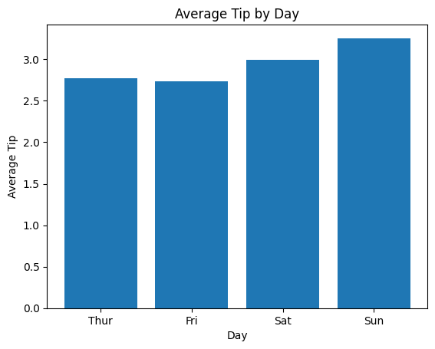
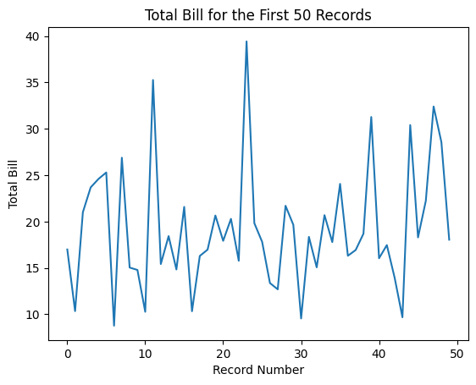
Bar Chart and Line Chart
Bar Chart – Average Tip by Day
Purpose: Compare the average tip for each day.
Shows: A higher bar means a higher average tip that day.
Line Chart – Total Bill (First 50 Records)
Purpose: Show how the total bill changes across records.
Shows: Each point is one record, connected in order.
Notes:
This slide has two charts. First, the Bar Chart. What is this chart? It is a bar chart. Why did we use it? We used it to compare the average tip for each day. What data did we use? The day column and the average of the tip column, grouped by day. What does it show? Each bar represents one day; a higher bar means the average tip was higher that day. For example, Sunday has the tallest bar, so tips were highest on Sunday. Second, the Line Chart. This is a line chart. We used it to show how the total bill changes across the first 50 records in the dataset. Each point on the line is one record, and the points are connected in the order they appear. It shows the ups and downs in total bill amount from one customer to the next.

Slide 6
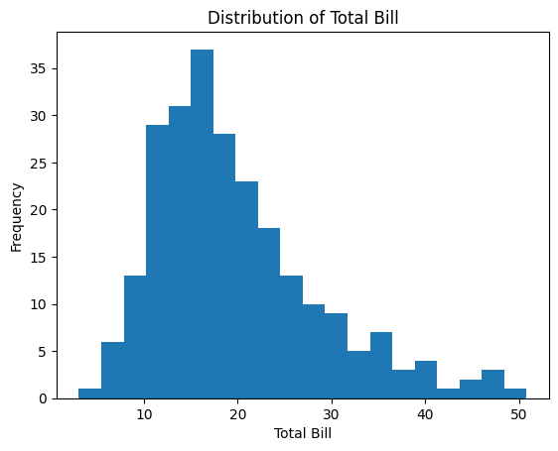
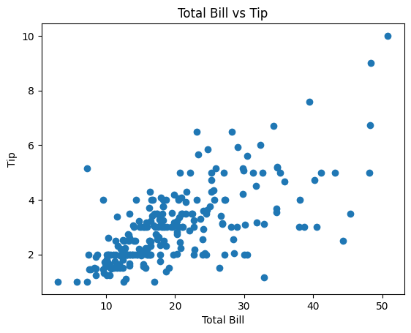
Histogram and Scatter Plot
Histogram – Distribution of Total Bill
Purpose: Show how total bill amounts are spread out.
Shows: Taller bars mean more bills fall in that range.
Scatter Plot – Total Bill vs Tip
Purpose: Show the relationship between total bill and tip.
Shows: Each dot is one customer; bigger bills tend to get bigger tips.
Notes:
This slide has two charts. First, the Histogram. This is a histogram. We used it to show how the total bill amounts are spread out. We used the total_bill column, split into bins. Taller bars mean more bills fall in that price range. For example, most bills are between 10 and 20 dollars. Second, the Scatter Plot. This is a scatter plot. We used it to show the relationship between total bill and tip. Each dot represents one customer. As the dots move up and to the right, it suggests that bigger bills tend to come with bigger tips.

Slide 7
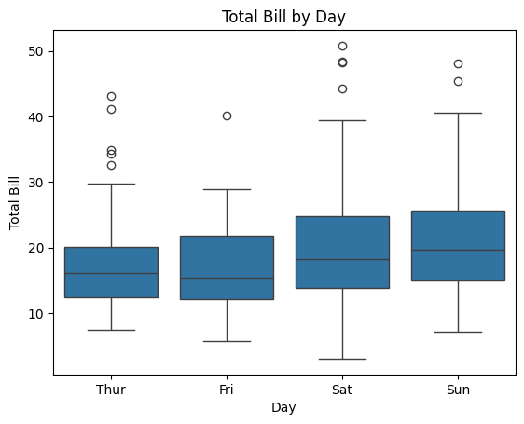
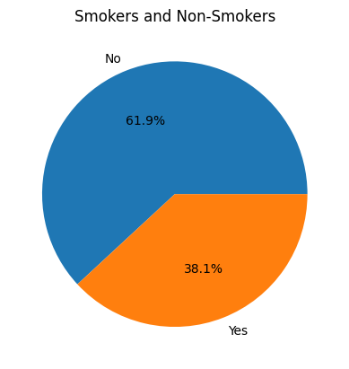
Box Plot and Pie Chart
Box Plot – Total Bill by Day
Purpose: Compare total bill amounts between days.
Shows: The box is the middle 50% of bills; dots are outliers.
Pie Chart – Smokers and Non-Smokers
Purpose: Show the share of smokers vs non-smokers.
Shows: Each slice is a percentage of the whole group.
Notes:
This slide has two charts. First, the Box Plot. This is a box plot. We used it to compare total bill amounts between the different days and to help spot outliers. We used the total_bill column, grouped by day. The box shows the middle 50 percent of the bills for that day, the line in the box is the median, and the dots outside the box are outliers, meaning unusually high or low bills. Second, the Pie Chart. This is a pie chart. We used it to show the share of smokers versus non-smokers in our data. We used the smoker column. Each slice represents a percentage of the whole group; for example, most customers in the dataset were non-smokers.

Slide 8
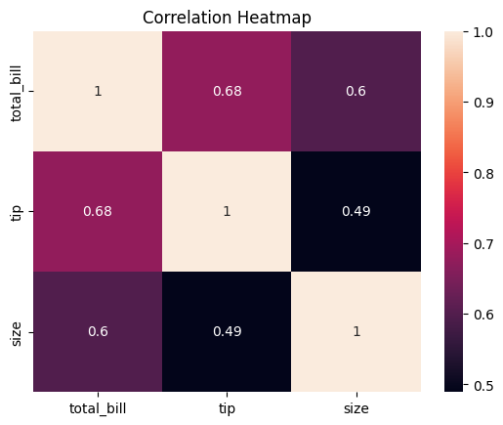
Heatmap
A heatmap uses color and numbers to show how variables relate to each other.
We used total_bill, tip, and size.
Numbers closer to 1 mean a stronger relationship.
Here, total_bill and tip are closely related.
Notes:
This is a heatmap. A heatmap uses color and numbers together to show how variables relate to each other. We used three columns: total_bill, tip, and size. Each cell shows a number between 0 and 1; numbers closer to 1 mean a stronger relationship between the two variables, and darker or lighter colors help us see this at a glance. From our heatmap, total_bill and tip are closely related, which makes sense because customers who spend more tend to tip more.

Slide 9
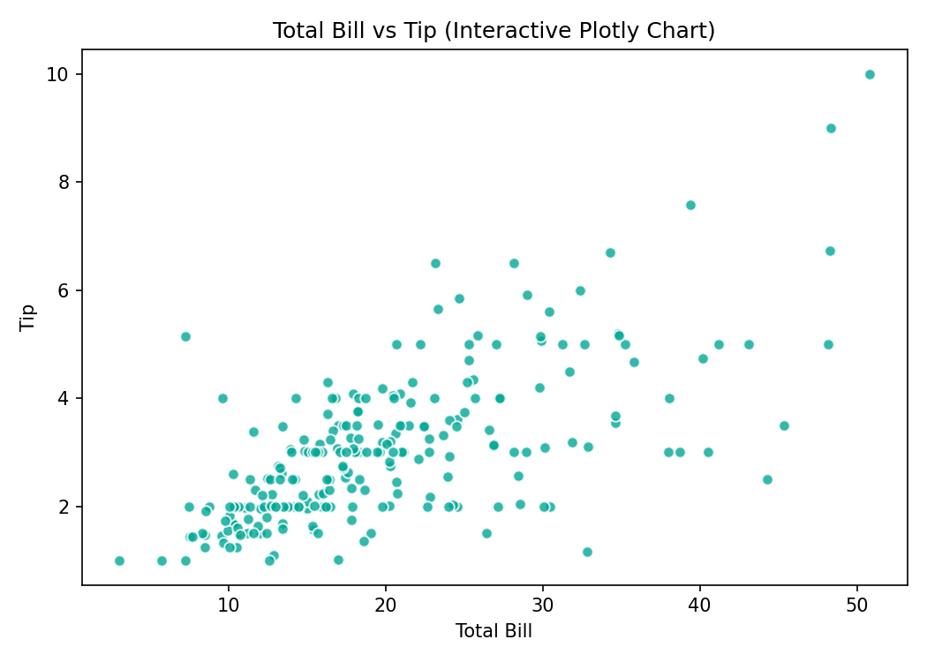
Interactive Plotly Chart
Plotly was used to make this chart interactive.
It shows total_bill vs tip, same data as our scatter plot.
In the live notebook, you can hover over points and zoom in.
This makes it easier to explore the data closely.
Notes:
This is our interactive chart, made with Plotly. We used Plotly because it lets us interact with the chart, instead of just looking at a fixed image. It shows the same data as our scatter plot: total_bill versus tip. The difference between this and a normal scatter plot is that in the live notebook, you can hover over each point to see its exact values, and you can zoom in to look closely at a group of points. This makes it easier to explore the data in detail.

Slide 10
Best Practices in Data Visualization
Choose the correct chart for your data.
Use clear titles.
Label the x-axis and y-axis.
Keep charts simple.
Avoid unnecessary information.
Make charts easy to read.
Notes:
This slide lists best practices we followed. Choose the correct chart for your data. Use clear titles so anyone can understand what the chart is about. Label the x-axis and y-axis. Keep charts simple, and avoid unnecessary information that can confuse the reader. Overall, make sure charts are easy to read at a glance.

Slide 11
Conclusion
We learned how to use Matplotlib, Seaborn, Plotly, and Pandas to visualize data.
Charts helped us understand the Tips dataset more easily than raw numbers.
Data visualization is a useful skill for analyzing and presenting data.
Python makes it possible to create both simple and interactive charts.
Notes:
To conclude, we learned how to use Matplotlib, Seaborn, Plotly, and Pandas to visualize data. Charts helped us understand the Tips dataset more easily than just looking at raw numbers. Data visualization is a useful skill for analyzing and presenting data, and Python makes it possible to create both simple, static charts and interactive ones.

Slide 12
References
Cairo, A. (2016). The Truthful Art: Data, Charts, and Maps for Communication. New Riders.
Hunter, J. D. (2007). Matplotlib: A 2D graphics environment. Computing in Science & Engineering, 9(3), 90–95.
McKinney, W. (2017). Python for Data Analysis (2nd ed.). O'Reilly Media.
Plotly Technologies Inc. (2015). Collaborative Data Science. Plotly.
Tufte, E. R. (2001). The Visual Display of Quantitative Information (2nd ed.). Graphics Press.
Waskom, M. (2021). Seaborn: Statistical data visualization. Journal of Open Source Software, 6(60), 3021.
Notes:
These are the references we used for our research and background reading on data visualization and the Python libraries.

Slide 13
Notes:
Thank you for listening. We are happy to answer any questions.

